Slide 1
A Low-Cost, Low-Complexity, and Memory-Free Architecture of Novel Recursive DFT and IDFT Algorithms for DTMF Application
Eshant Verma
(160102024)
Dheeraj Saraf
(160102021)

Slide 2
Introduction
The discrete Fourier transform (DFT) has been widely applied in the field of signal processing. Dual-tone multifrequency (DTMF) approaches to the voice-over-packet (VoP) network use Goertzel’s algorithm to compute the interested frequency. To meet the International Telecommunications Union frequency specifications Felder et al. It is suggested to use two different frame sizes for both the high group (a frame size of 212) and low-group (a frame size of 106) frequency specifications.

Slide 3
The architectures for recursive DFT (RDFT) algorithms
have been completely developed and have the advantages
of high data throughput, low power use, and small
area requirement compared to digital-signal-processing-based
designs.

Slide 4
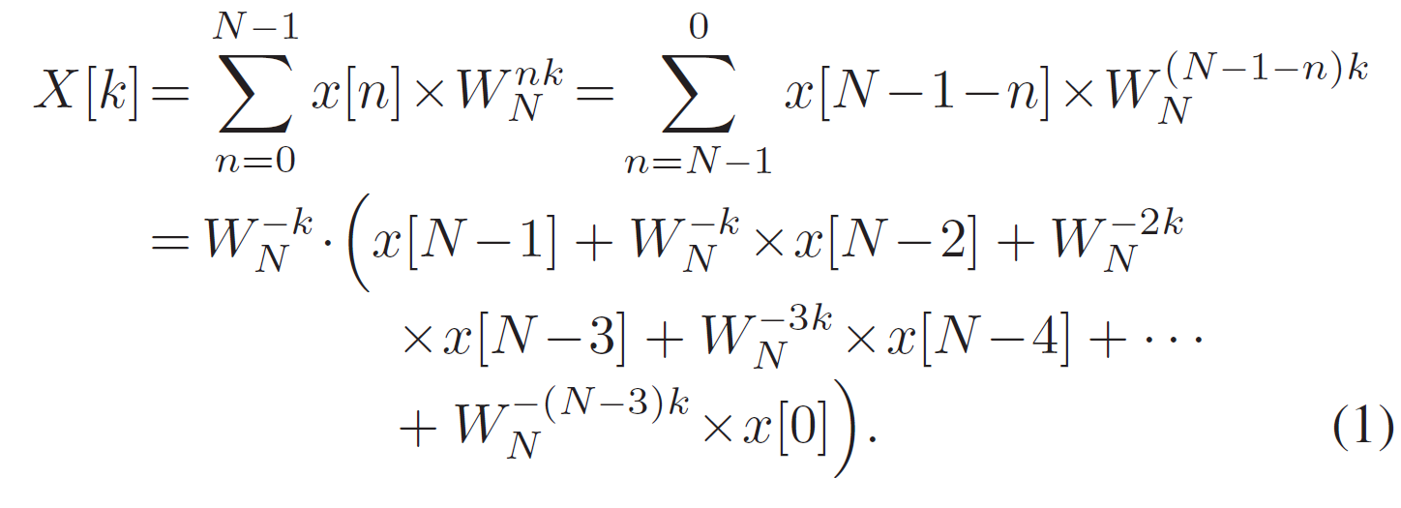
RDFT Algorithm
The DFT formula can be derived as follows by reordering the
index and expressing the sigma function:

Slide 5
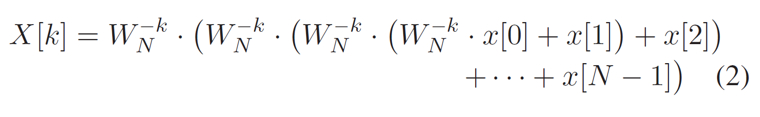

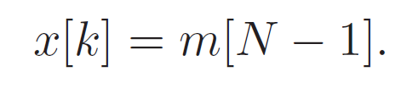
This gives us the recursive formula:
The kernel function of the difference equation is defined as

Slide 6
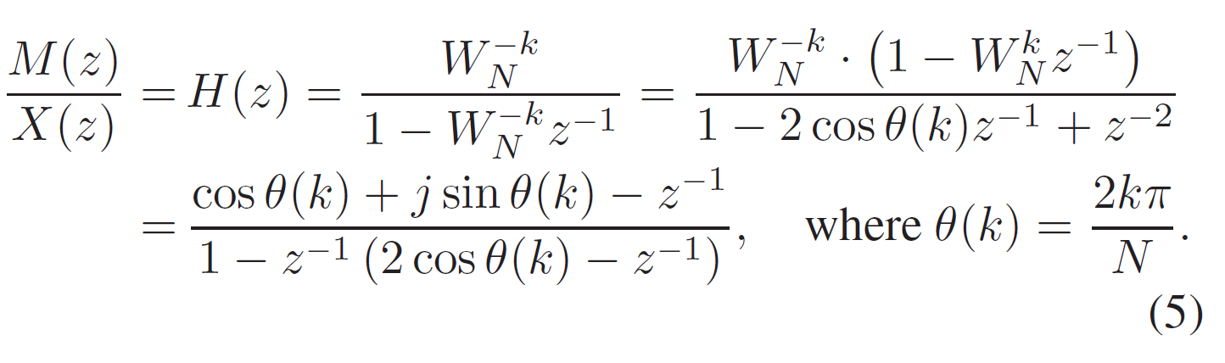
Now, the difference equation (4) can be expressed as a z-transform. The transfer function H(z) is obtained as

Slide 7
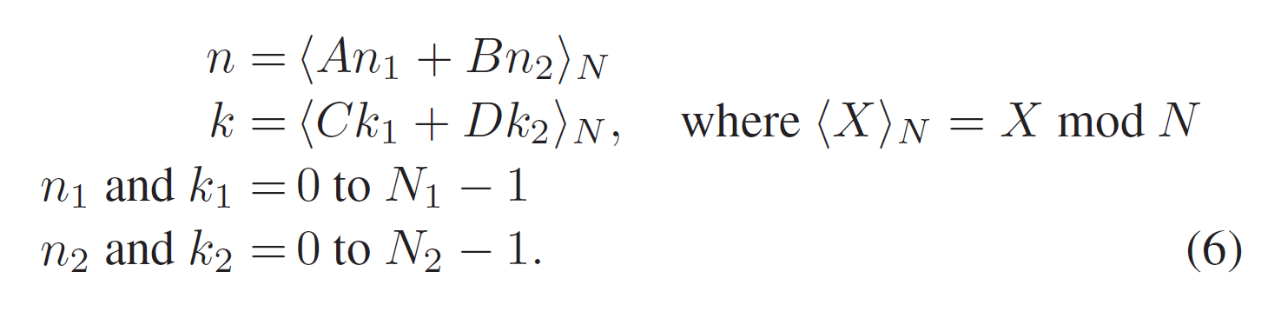
Multicycle RDFT Algorithm With the CRT
If the input sequence length N can be factored into two mutually prime factors (N1 and N2), then we can take a change of the variables as

Slide 8
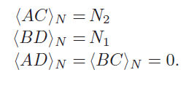
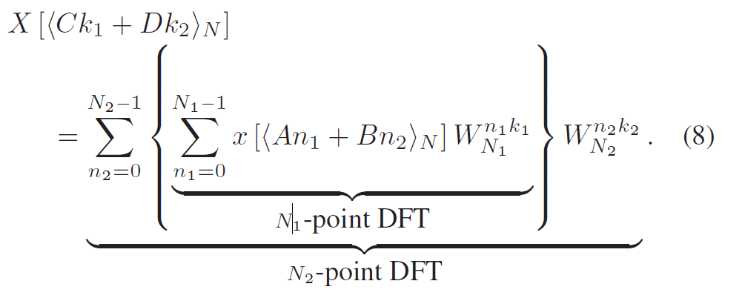
For this mapping to be unique, conditions A, B, C, and D must be chosen such that:
Thus, the DFT algorithm with the CRT can be derived as

Slide 9
For example, if we need a 212-point RDFT with the CRT, the values of (A,B,C,D) can be calculated as in the following steps.
Step 1: Assume that N = 212. Then, N can be factorized as N₁ X N₂. 212=53X4(N₁=53 and N₂=4).
Step 2: Let A=N₁=53 and B=N₂=4. Then, C=N₁’XN₁=N₁’X53 and D=N₂’XN₂=N₂’X4.
Step 3: Figure out a value for C that can satisfy <C>_{N2} is equal to 1. Then, we find that the minimum value of C is equal to 53 when N₁’=1.
Step 4: Figure out a value for D that can satisfy <D> _{N1} is equal to 1. Then, we find that the minimum value of D is equal to 160 when N₂’=40

Slide 10
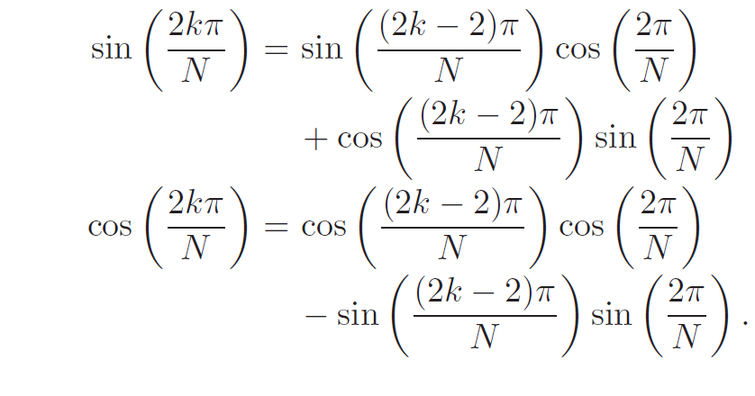
Algorithm for calculating Sine and Cosine
We know that:
This shows that to calculate the new values we can simply use the pre-existing old values

Slide 11
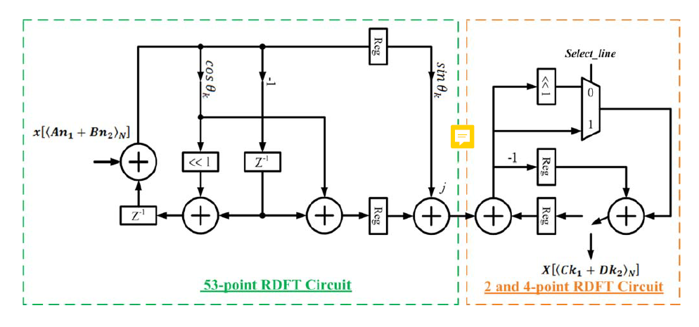
Proposed architecture

Slide 12
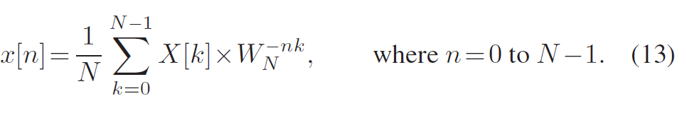
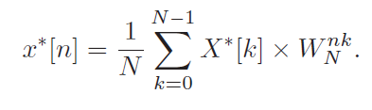
IDTF
The IDFT of an N-point input sequence X[k] is defined as
The efficient computational algorithm caused by the DFT and
the IDFT involves the same kernel. After taking complex conjugate of (13), the same kernel can be obtained, i.e.,

Slide 13
It can be seen that the IDFT can be performed by the DFT. The only difference is in the complex conjugate of the input/output sequence. In summary, there are three steps to achieving the recursive IDFT: First, take the complex conjugate of the input sequence. Then, apply the proposed DFT algorithm. Finally, take the complex conjugate of the output sequence and divide it by N.

Slide 14

The Number System
As it is not easy to store non-integral values in binary, and our test cases may have values which can be less than 1, thus using simple binary format was not enough.
To tackle the problem of storing smaller values and increase the accuracy of the system we store numbers with a multiplier of 10⁶.

Slide 15
To incorporate the imaginary part of a complex number we have included another set of inputs and outputs that run parallelly with the real inputs.
All the data types are vectors of 32 bits with clock period of 10ns, which if wanted can be changed easily.

Slide 16
Important Modules Included
Delay(delay)
Adder(addr)
Negative(neg)
Two(tw)
Complex Conjugate(conj)
53-point RDFT(lrg)
2-point DFT(tp)
106-point RDFT(rdft)
IDFT(idft)

Slide 17
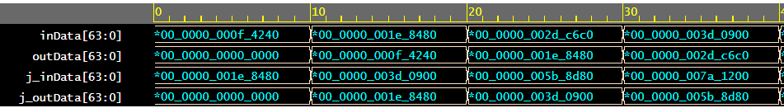
Delay
A clocked delay module, capable of producing delay of one clock cycle.
It has the functionality of reset which, if activated would set the output of the module to 0.

Slide 18
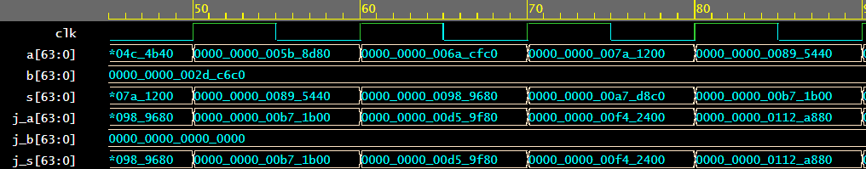
Adder
A simple adder with capability of adding complex numbers and functionality of reset to give 0 at rising edge of reset

Slide 19
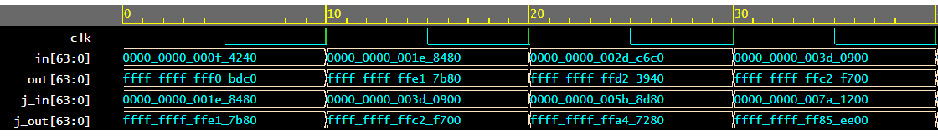
Negative
A simple module capable of giving negative of whatever input if being fed to it in rising clock edge, in the form of 2s compliment.

Slide 20
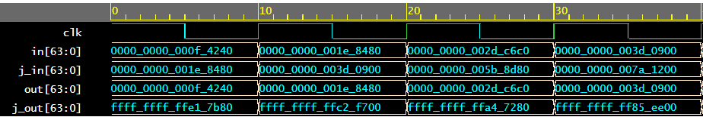
Complex Conjugate
Inputs a complex number and outputs its complex conjugate

Slide 21
53-point RDFT
An important module with 4 adders, 2 delay units, one negative unit and on multiply by 2 unit

Slide 22
Implementing 106-point RDFT
The RDFT was implemented by using the 53-point RDFT and 2-point DFT to get the 106-point RDFT.
Inputs were given as series of natural numbers starting from 1 (in our architecture it would be 1,000,000)

Slide 23
Implementing IDFT
As discussed earlier IDFT uses the same architecture with the exception of having its inputs and outputs complex conjugated as discussed in the paper.

Slide 24
Known issues
Many times there was handshaking problems encountered which might be solved with proper timing analysis and proper consideration of setup and hold times
There was a loss of accuracy during many operations which may seem to add up together to get us an inaccurate value of output
During simulations, a lot of new issues were encountered on one tools but were not and issue on other tools.

Slide 25
Thank You

